Slide 1
Principles of assessment in the clinical setting
Adriana Venturini, PT, MSc
Assistant professor (professional) , ACCE Physical Therapy Program
Adapted from Valérie Dory, MD PhD
Undergraduate Medical Education
Faculty Development Team, Faculty of Medicine
Marion Dove, MD, Beth Cummings, MD, Laurie Plotnick, MD
McGill University
Spring Clinical Day June 10th, 2015

Slide 2
Assessment is challenging 'you don't want to sort of be the one who sticks the knife in them'
Potential negative outcomes for learner and assessor
Perceived lack of competence
Challenge of documentation
Challenge of providing useful feedback and remediation
Dudek et al. 2005; Cleland et al. 2008; Rees et al. 2009

Slide 3
Assessment as educational reasoning
Data
Interpretation
Decision
History includes key questions about relevant hypotheses
End of rotation objectives
Pass
Assessment organised
Standards of care
Case presentation coherent
Good CR
Feedback
Intervention - skilled
Previous student
Entrust
Notes well organized
The way I do things

Slide 4
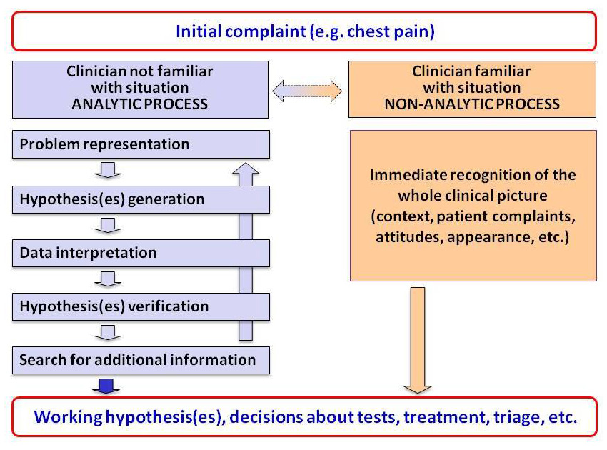
Clinical reasoning
Data
Interpretation
Decision
Nendaz & Perrier 2012

Slide 5
The “W-5” of assessment
Why do we assess?
When do we assess?
What do we assess?
HoW do we assess?
Who assesses?
Notes:
This slide – the W-5 of assessment – frames the content of this plenary.

Slide 6
Epstein 2007
3 categories of goals for assessment:
Selection purposes – choose students for positions where there are more candidates than places
Protect patients – ensure that only competent individuals are allowed to practice
Optimize learning – before, during, and after the assessment

Slide 7
Optimizing learning
Before the assessment
Objectives convey what is important to learn
Extrinsic motivation
During the assessment period
Provides an opportunity to practice and hence to increase retention
After the assessment
Provides feedback to students to direct future learning
Provides feedback to educators to direct curriculum
Ensures students have met prerequisites to progress in training
Identifies students in need of remediation

Slide 8
Summary
Why assess students?
Tells students what is important to know
Allows monitoring of progress
Enhances learning and retention
Increases motivation and commitment

Slide 9
When should we assess?
If you ask students…
“ … we are always being assessed …”
“…we never get feedback…”

Slide 10
The Assessment Continuum
A
B
Formative assessment
Summative assessment
Notes:
This slide highlights the importance of giving feedback to the learner, based on ongoing assessment, or formative assessment.

Slide 11
The Assessment Continuum
Formative Assessment:
Assessment done with the intent of providing ongoing information for individual or program modification
Summative Assessment:
Assessment done at the end of a course or program to determine whether the individual or program has met a set of predetermined expectations.

Slide 12
What Do We assess?
Knowledge
Competencies
Skills
Attitudes
Notes:
As mentioned earlier, competence includes Knowledge, Attitudes and Skills, and all three should be included in the assessment process.
Teachers often find the assessment of attitudinal problems to be most challenging. It is important to note that assessment usually drives learning. Thus, if we truly value something (e.g. professional behaviors), we should assess it.
The methods required to adequately assess knowledge vs. attitudes vs. technical skills are quite different and must be carefully considered.

Slide 13
What Do We assess?
Our profession specific roles:
Expert
Communicator
Collaborator
Manager
Health Advocate/Change agent
Scholar
Professional
Notes:
The CanMEDS roles form the framework for assessment in postgraduate medical education at McGill. All but one of the seven reflect knowledge, attitudes and skills that fall outside of the realm of ‘medical expert’.

Slide 14
What Do We assess?
Knowledge
Basic sciences, clinical sciences
Competencies
Expert
Skills
Data gathering, hypothesis generation, assessments, designing treatment plan
Attitudes
Responsibility in discharging duties
Notes:
As mentioned earlier, competence includes Knowledge, Attitudes and Skills, and all three should be included in the assessment process.
Teachers often find the assessment of attitudinal problems to be most challenging. It is important to note that assessment usually drives learning. Thus, if we truly value something (e.g. professional behaviors), we should assess it.
The methods required to adequately assess knowledge vs. attitudes vs. technical skills are quite different and must be carefully considered.

Slide 15
What Do We assess?
Knowledge
Knowledge of professional norms
Competencies
Professional
Skills
Developing therapeutic relationship
Attitudes
Respect
Altruism
Notes:
As mentioned earlier, competence includes Knowledge, Attitudes and Skills, and all three should be included in the assessment process.
Teachers often find the assessment of attitudinal problems to be most challenging. It is important to note that assessment usually drives learning. Thus, if we truly value something (e.g. professional behaviors), we should assess it.
The methods required to adequately assess knowledge vs. attitudes vs. technical skills are quite different and must be carefully considered.

Slide 16
What Do We assess?
Does
Shows How
Knows How
Knows
Miller, 1990
Notes:
Miller’s pyramid describes different levels of competence, from the simplest level (the base of the pyramid) to the most complex level (the tip of the pyramid). For example, a learner may be aware (know) of the importance of good communications skills when conducting an interview with an interpreter, be able to describe (know how) the principles of how this should be done, demonstrate (show how) these communication skills in a role play or simulation, and finally communicate according to these principles in the clinical setting (does).
As much as possible, we should strive to assess the ‘tip of the pyramid’, which is often the most difficult to assess. This requires direct observation ‘in the field’, and is the most ‘authentic’ assessment of clinical competence.

Slide 17
How do we assess?
Stimulus = task
Real patient(s) Clinical care, technical procedure
Simulation Mannekin, high fidelity simulation, standardized pt, rater role playing
Clinical scenario Paper/computer-based vignette, video
Knowledge question
Does
Shows how
Knows how
Knows

Slide 18
How do we assess?
Response = data collected
Observation (live, video) Oral Written (chart review)
Observation (live, video) Simulator records
Oral Written (open) Written (closed)
Oral Written (open) Written (closed)
Does
Shows how
Knows how
Knows

Slide 19
Reliability
The consistency with which a method measures what it is designed to measure
Validity
The degree to which a method
measures what it is intended to measure

Slide 20
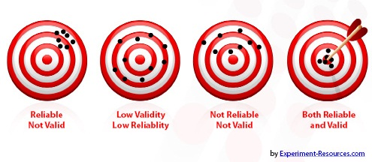
Reliability and validity

Slide 21
To Improve Reliability of your Assessment Program… Multiply!
Multiple Methods
Multiple Observations
Multiple Observers

Slide 22
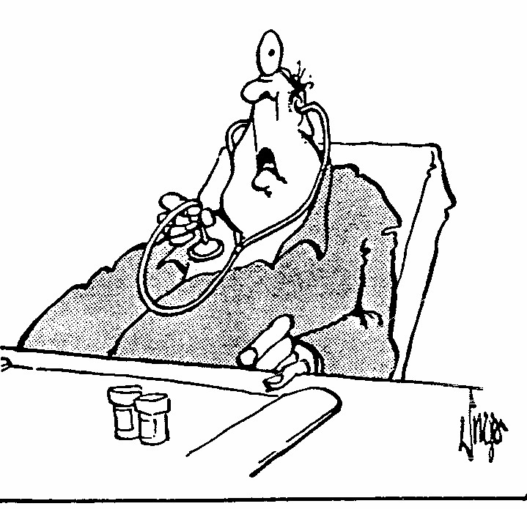
Who ASSESSes?
Supervisors/teachers
Other health care professionals
Self
Peers
Students
Patients
Licensing/national bodies
“Testing . . . testing.”
Notes:
It is also important to review WHO will be evaluating the learning and to discuss the benefits of multiple stakeholder perspectives.

Slide 23
The Bottom Line
Know why you are assessing
Know what you are assessing
Match your method to your objective
Be specific
Involve the learner
Document

Slide 24
In summary:
Assessment should not be a surprise!
Assessment is more than the completion of a form.
Why do we think about assessment last
when learners think about it first?
Weston, 2004
Notes:
This slide once again emphasizes the direct link between on-going feedback (formative assessment) and the final summative evaluation. If there is in fact no link, then true evaluation or assessment has not been done adequately.

